Slide 1
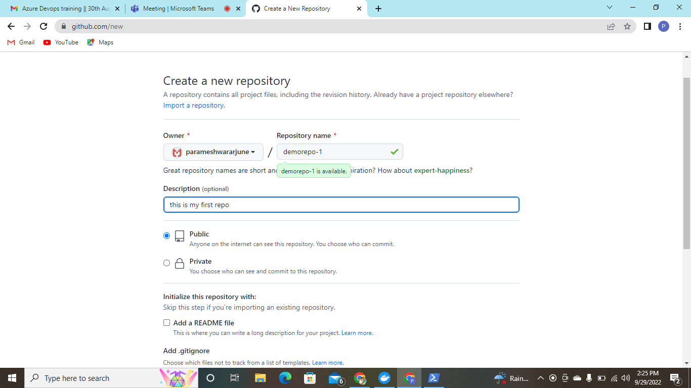
Git-hub- creation of new repository

Slide 2
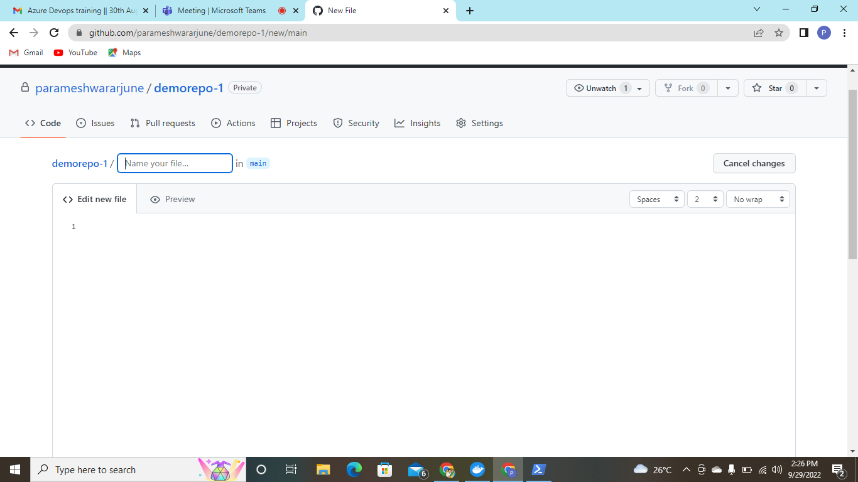
Created new repository –demorepo-1

Slide 3
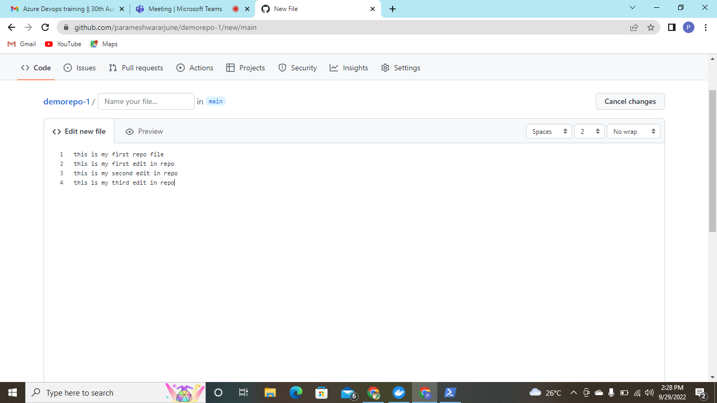
Adding new file inside the demorepo-1

Slide 4
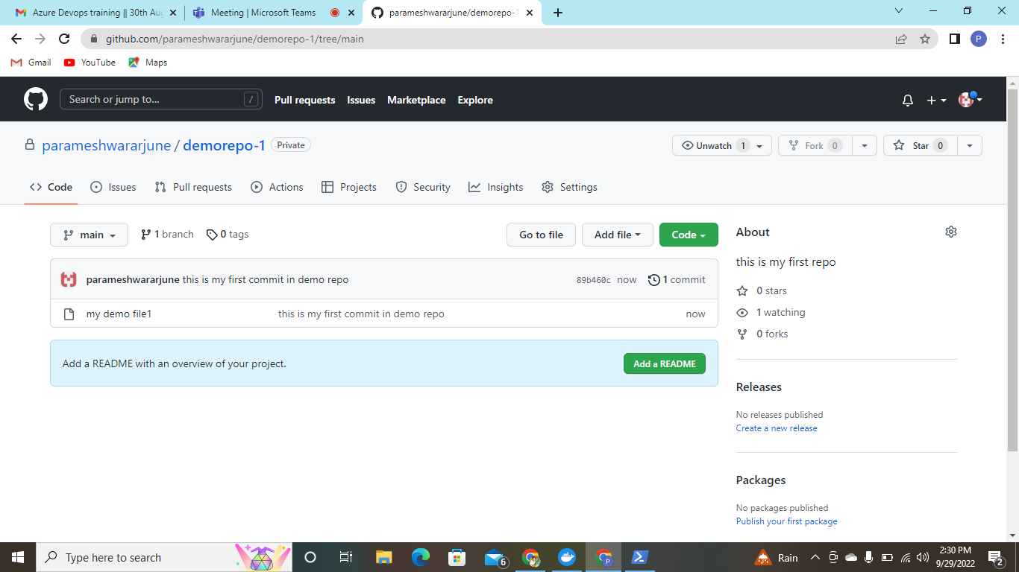
Added commit

Slide 5
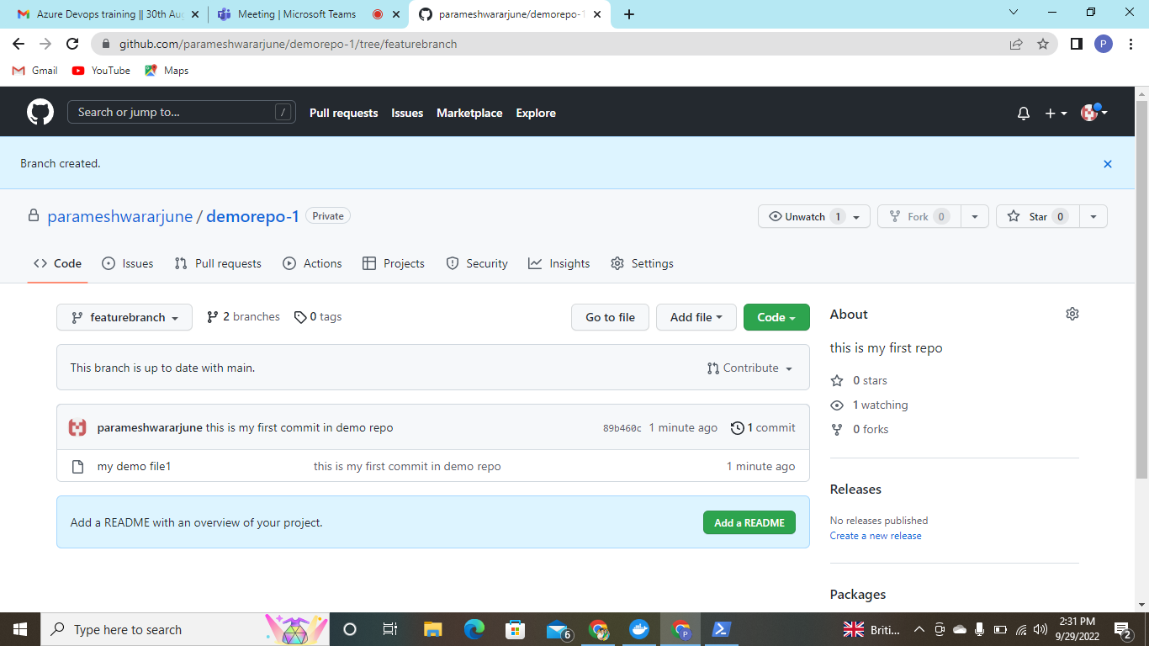
Creating new feature branch from the main branch

Slide 6
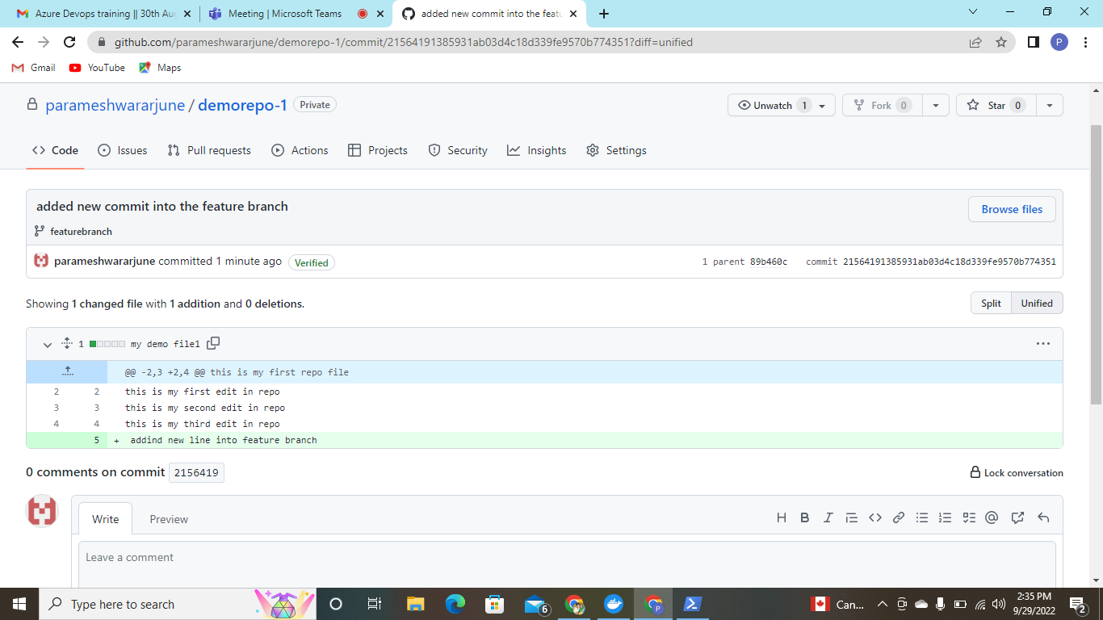
Adding new file inside the feature branch

